Slide 1


Late Purushottam Hari (Ganesh) Patil Shikshan Sanstha’s
Mauli Group of Institution’s
College of Engineering and Technology Shegaon.
Project Name:
Forecasting and Visualization of Stock using Dash Framework
Submitted by:
1. Vishal Mali
2. Shreyash Sable
3. Shantanu Ghate
4. Anjali Gheghate
5. Sejal Idhol
Guided By : Dr.P.M.Hasabnis
Department of Computer Science and Engineering
Session : 2022-23

Slide 2
CONTENTS
Problem Statement
Introduction
Literature Review
Technologies
Approach
Project Stages
Advantages
Conclusion

Slide 3

PROBLEM STATEMENTS
Developing an interface between human and the System using the machine learning algorithms and python language to predict the price of the stock using long short – term memory Network.

Slide 4
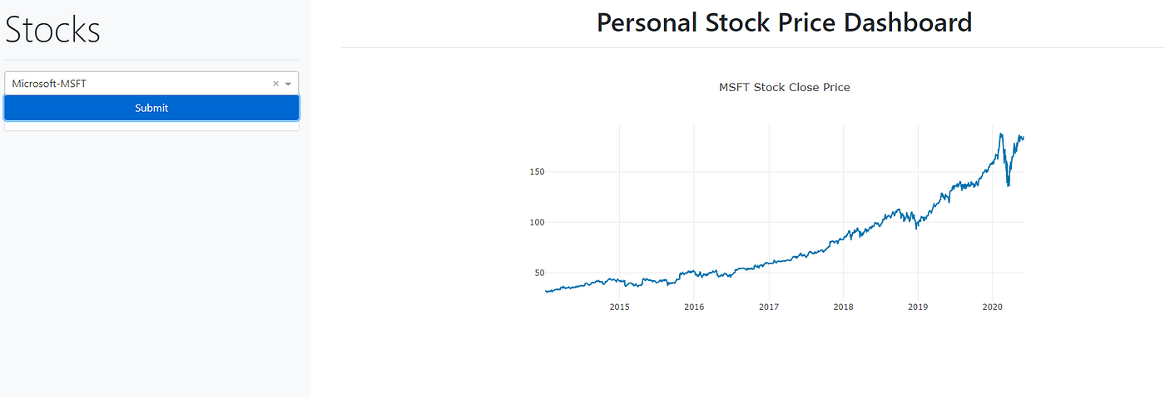
INTRODUCTION
What is Dash Framework?
Dash is open-source framework for building data visualization interfaces. It was released in 2017 as python library. Dash Framework helps data scientist build analytical web applications without requiring advanced knowledge of web development.

Slide 5

Stock Market Prediction
Stock market prediction is the act of trying to find the upcoming future value of a company stock or other financial instrument traded on an exchange. The successful prediction of a stock's future price could yield notable profit.
Data Visualization
Data visualization is one of the most efficient ways to assist investors to have a clear overview of movements of the stock market, as well as providing a deeper understanding of each individual stock.
In stock market, Data visualization helps traders when making decisions quickly and enables them to easily synthesize large amounts of complex information.

Slide 6
Introduction to Long Short – Term Memory
The Long Short-Term Memory is a special type of RNN.
It is efficient of catching the data from previous Stages and use it for upcoming future predication.
LSTMs are widely used for sequence prediction problems and have proven to be extremely successful.
The reason behind is they work so well is because LSTM is able to store historic information that is important and forget the information that is not.
LSTM has three gates:
1. The input gate: The input gate adds details to the cell state.
2. The forget gate: It removes the details that is no longer required by the model.
3. The output gate: Output Gate at LSTM selects the details to be shown as output

Slide 7
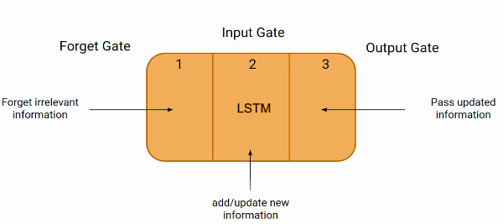
fig. LSTM Cell

Slide 8
LITERATURE REVIEW
Authors | Name of Paper | Published Year | Approach
Ashutosh Sharma, Sanket Modak, Eashwaran Sridhar | “Data Visualization and Stock Market Prediction.” | 2019 | Financial market directly enhanced long-run Growth through financial intermediaries.
Shazia Usmani, Jawwad A Shamsi | “News Sensitive Stock Market Prediction” | 2021 | Financial time series data encompasses dynamic and historical data.
Krishna Bhambani, Tanmay Jain, Dr. Kavita A Sultanpure | “Stock Market Prediction Performance of Neural Networks” | 2017 | According to the efficient market hypothesis, Stock prices cannot be forecasted by investors since market reflect all of the currently available information.

Slide 9
TECHNOLOGIES REQUIRED
Hardware Requirements:
Computer System with
4GB Ram,
500GB Storage,
OS with Windows 7 and above.
Software Requirements :
Python 3.5 & above
Visual Studio Code
Libraries – Dash, Plotly, Yfinance, Scikit-Learn etc.

Slide 10
APPROACH
3
1
2
5
4
Make a main website’s structure using mainly Dash HTML Components and Dash Core Components
Generate plots of data using the plotly library of Python.
Implement a Machine Learning model to predict the stock price for the dates requested by the users.
Enhance the site’s UI
by styling using CSS.
The data is fetched using yfinance Python library.

Slide 11
PROJECT STAGES
Input stock code to get the company information.
Select date range to get stock price and estimated moving average plots
Input number of days to get forecast
Deployment of model.
Stage 1
Stage 2
Stage 3
Stage 4

Slide 12
ADVANTAGES
It helps Traders to know better about his entry or exit points, so often the traders either enter or exit the market at the wrong times which means they fail to capitalize on full potential of making profits.
It is high in interpretability as the user can know which factor influences the price of stock more and by how much.

Slide 13
CONCLUSIONS
Stocks forecasting and visualization using dash is a machine learning project we will built a single page web application using plotly dash python framework and using some machine models to get company’s information and plot graphs for visualization based on it. The stock market forecasting is done using machine learning model(SVR).
Dash provides a fast and quick way of creating beautiful and interactive dashboards without extensive knowledge of web development. It combines web development and analytics and provides a useful mechanism for serving dashboards for web response. In stock market, Data visualization helps traders when making decisions quickly and enables them to easily synthesize large amounts of complex information Easy interaction between the normal people and disables

Slide 14
THANK YOU !!!!

